Slide 6
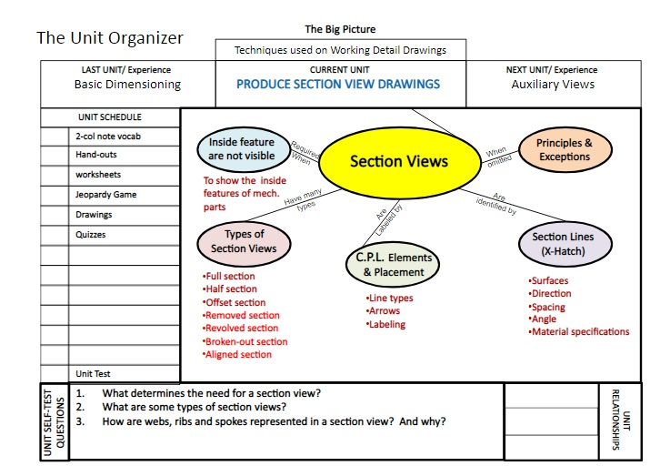

Slide 9
Excersice And
Homework

